Slide 2

Git & GitHub
Let's Start
Speaker :
Harshavardhan Bajoria

Slide 3





About Me :
Founder of Devorld
Microsoft Certified AI Engineer and Data Scientist.
Intern at Unstop (formerly Dare2Compete) and ex-intern at GeeksforGeeks, PrepForTech, Coding Minutes.
6X Microsoft Certified
Finalist at Amdocs HackFest 2022
hvbajoria
harshavardhan-bajoria

Slide 4
Prerequisites
A GitHub account

Slide 5
Learning objectives
Make commits
Check logs, status
Understanding use of SHA
Create remote repo
Create a branch
Commit changes to the branch
Create a pull request
Merge the pull request
Delete the branch

Slide 6
Agenda
Introduction
What is Git?
Basic commands using Git
What is GitHub?
Basic commands using GitHub
Quiz
Summary

Slide 7
Introduction

Slide 8

WHAT IS GIT ?
Git is a distributed version control system that is free and open source.
It has been used for many small and large projects like Linux.

Slide 9



WHAT IS VERSION CONTROL ?
Content
Teams
Agility
Complete history is tracked
- Allows Collaboration
- Team communication and
reviews
- Adapt quickly
- Easily test, fix or undo
any change

Slide 10



WHAT IS OPEN-SOURCE ?
Open source software are softwares with a source code that can be accessed by anyone.
Anyone can fork, make enhancements and push it back so that everyone can use it.

Slide 11
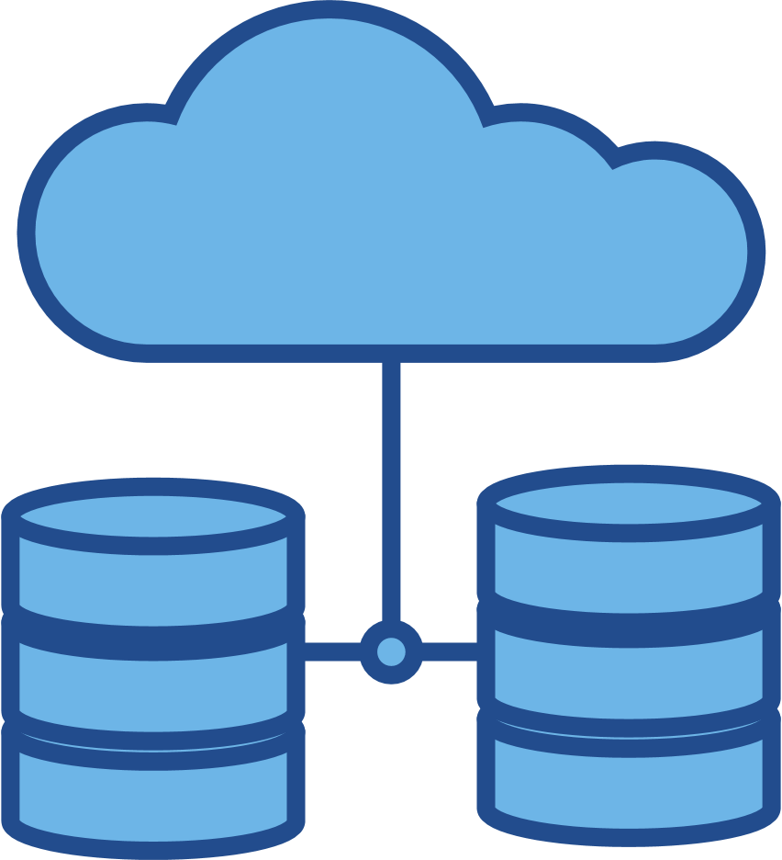





LOCATIONS OF GIT
a457 fileA
c671 dirB
Working Tree
Staging Area
Local Repository
Remote Repository
Project Directory
Project Directory
Project Directory

Slide 12








EXAMPLE
Staging
Commit
Working
Tree
local
repository
Remote Repository
Project Directory

Slide 13
GIT GRAPH
Git models the relationship of commits with Directed Acyclic Graph.
The arrow points at the commits parent.
B
A
D
C

Slide 14
What is GitHub?

Slide 15
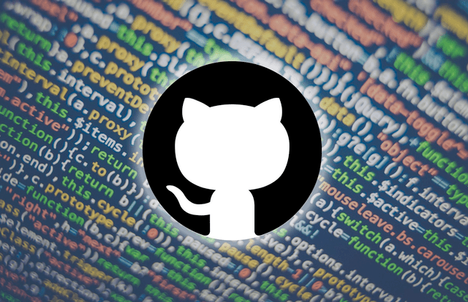
Introduction
GitHub is a development platform that enables you to host and review code, manage projects, and build software alongside 50 million developers.
This Photo by Unknown Author is licensed under CC BY-SA-NC
Notes:
GitHub is a development platform that enables you to host and review code, manage projects, and build software alongside 50 million developers.
Why is everyone building on GitHub? Because it provides the important DevOps features companies and organizations of all sizes need for their public and private projects. Whether it's planning features, fixing bugs, or collaborating on changes, GitHub is the place where the world's software developers gather to make things. And then make them better.
In this module, you learn to use key GitHub features, including issues, notifications, branches, commits, and pull requests.

Slide 16
The GitHub flow
In addition to providing a platform for collaborative software development, GitHub also offers a workflow designed to optimize use of its various features.
Notes:
In addition to providing a platform for collaborative software development, GitHub also offers a workflow designed to optimize use of its various features. While this unit offers a cursory overview of important platform components, it's recommended that you first review Understanding the GitHub flow.

Slide 17
Git and GitHub
As you work with Git and GitHub, you may wonder about the difference between the two.
Issues
Discussions
Pull requests
Notifications
Labels
Actions
Forks
Projects
Installed and used on your local machine
Handles version control
Supports branching
Notes:
As you work with Git and GitHub, you may wonder about the difference between the two.
Git is a distributed version control system (DVCS) that allows multiple developers or other contributors to work on a project. It provides a way to work with one or more local branches and push them to a remote repository. Git is responsible for everything GitHub-related that happens locally on your computer. Key features provided by Git include:
Installed and used on your local machine
Handles version control
Supports branching
To learn more about Git, see Using common Git commands.
GitHub is a cloud platform that uses Git as its core technology. It simplifies the process of collaborating on projects and provides a website, command-line tools, and overall flow that allows developers and users to work together. GitHub acts as the "remote repository" mentioned previously in the Git section.
Key features provided by GitHub include:
Issues
Discussions
Pull requests
Notifications
Labels
Actions
Forks
Projects
To learn more about GitHub, see Getting started with GitHub.

Slide 18
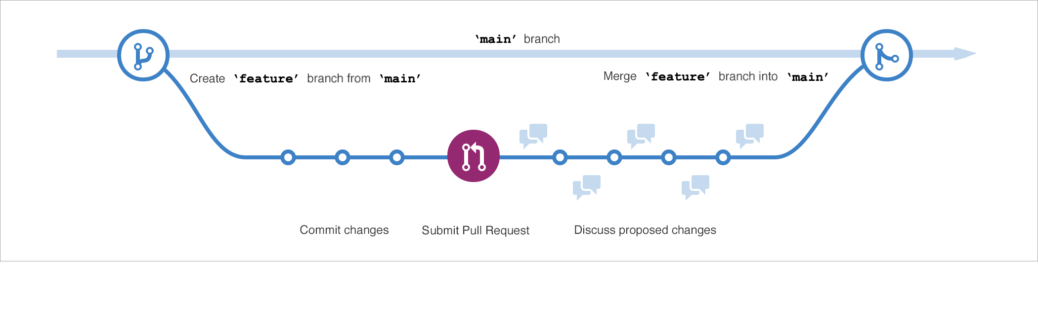
Branches
Branches are the preferred way to create changes in the GitHub flow.
Notes:
Branches are the preferred way to create changes in the GitHub flow. They provide isolation so that multiple people may simultaneously work on the same code in a controlled way. This model enables stability among critical branches, such as main, while allowing complete freedom for developers to commit any changes they need to meet their goals. Once the code from a branch is ready to become part of the main branch, it may be merged via pull request.
To learn more about GitHub branches, see About branches.

Slide 19
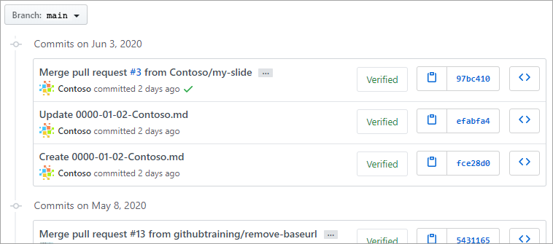
Commits
A commit is a change to one or more files on a branch.
Notes:
A commit is a change to one or more files on a branch. Every time a commit is created, it is assigned a unique ID and tracked, along with the time and contributor. This provides a clear audit trail for anyone reviewing the history of a file or linked item, such as an issue or pull request.
To learn more about GitHub commits, see Committing and reviewing changes to your project.

Slide 20
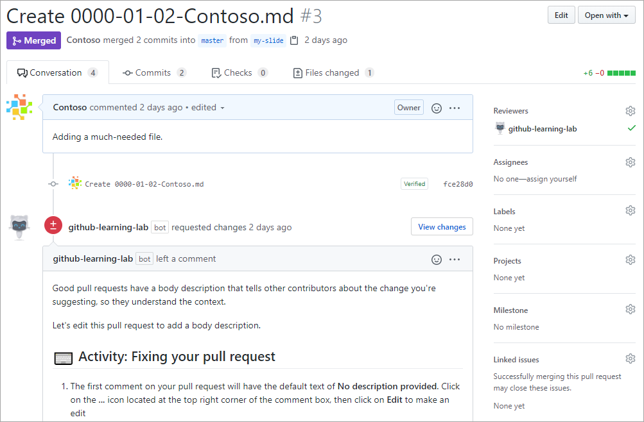
Pull Requests
A pull request is the mechanism used to signal that the commits from one branch are ready to be merged into another branch.
Notes:
A pull request is the mechanism used to signal that the commits from one branch are ready to be merged into another branch. The developer submitting the pull request will often request one or more reviewers to verify the code and approve the merge. These reviewers have the opportunity to comment on changes, add their own, or use the pull request itself for further discussion. Once the changes have been approved (if approval is required), the pull request's source branch (the compare branch) may be merged in to the base branch.
To learn more about GitHub pull requests, see About pull requests.

Slide 21
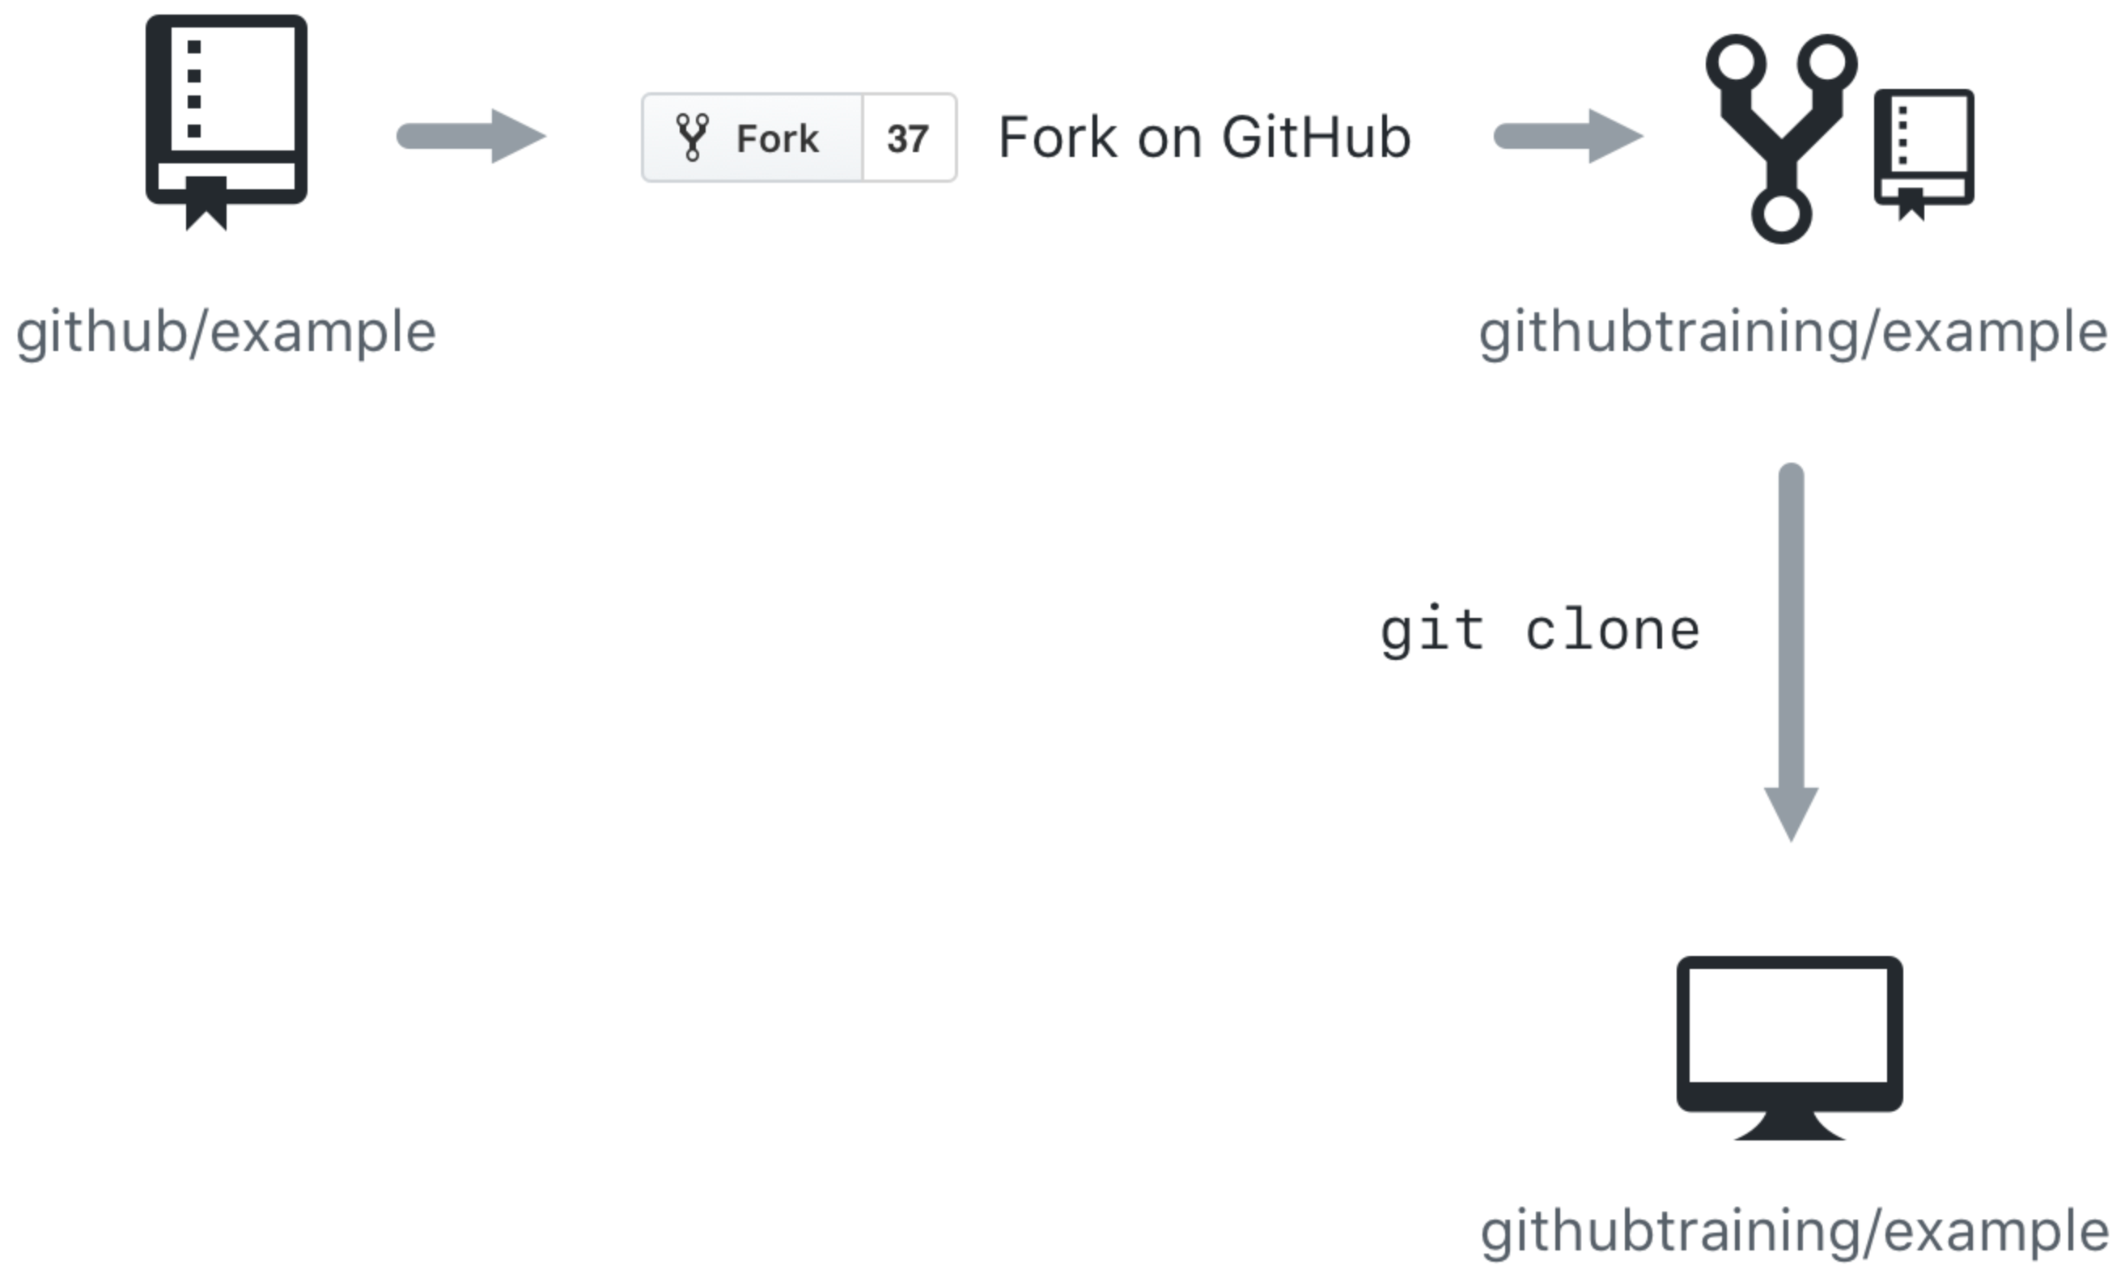
Cloning and forking
GitHub provides multiple ways to copy a repository so that you can work on it.
Cloning a Repository - Cloning a repository will make a copy of the repository and its history on your local machine. If you have write access to the repository you can push changes from your local machine to the remote repository (called the origin) as they're completed. To clone a repository you can use the git clone [url] command or the GitHub CLI's gh repo clone [url] command.
Forking a Repository - Forking a repository makes a copy of the repository in your GitHub account. The parent repository is referred to as the upstream while your forked copy is referred to as the origin. Once you've forked a repository into your GitHub account you can clone it to your local machine. Forking allows you to freely make changes to a project without affecting the original upstream repository. To contribute changes back to the upstream repository you create a pull request from your forked repository. You can also run git commands to ensure that your local copy stays synced with the upstream repository.
Notes:
GitHub provides multiple ways to copy a repository so that you can work on it.
Cloning a Repository - Cloning a repository will make a copy of the repository and its history on your local machine. If you have write access to the repository you can push changes from your local machine to the remote repository (called the origin) as they're completed. To clone a repository you can use the git clone [url] command or the GitHub CLI's gh repo clone [url] command.
Forking a Repository - Forking a repository makes a copy of the repository in your GitHub account. The parent repository is referred to as the upstream while your forked copy is referred to as the origin. Once you've forked a repository into your GitHub account you can clone it to your local machine. Forking allows you to freely make changes to a project without affecting the original upstream repository. To contribute changes back to the upstream repository you create a pull request from your forked repository. You can also run git commands to ensure that your local copy stays synced with the upstream repository.
When would you clone a repository versus fork a repository? If you're working with a repository and have write access you can clone it to your local machine. From there you can make modifications and push your changes directly to the origin repository.
If you need to work with a repository created by another owner such as github/example and don't have write access, you can fork the repository into your GitHub account, and then clone the fork to your local machine. To see this visually, let's assume that your GitHub account is called githubtraining for this example. Using the GitHub website you can fork githubtraining or any other examples into your account. From there you can clone the forked version of the repository to your local machine. These steps are shown in the following image.
Changes can be made to your local copy of githubtraining/example and then pushed back to your remote origin repository (githubtraining/example). The changes can then be submitted to the github/example upstream repository using a pull request as shown next.
To learn more, see Fork a repo.

Slide 22
Workshop walk-through
Fork a repo, create a branch, make a change, push it, delete branch

Slide 23
Quiz Time! Let’s see how much you have learnt

Slide 24

Form Link: https://forms.office.com/r/v5V36iCfiN

Slide 25
Summary

Slide 26
Summary
In this module, you learned about the key features of GitHub and how to use it with GitHub.dev, including commits, branches, and pull requests.
Notes:
In this module, you learned about the key features of GitHub, including issues, commits, and pull requests. You also used GitHub Pages to publish a public site based on the contents of your project.
You learned about:
Communicating with the project community in issues
Managing notifications for project events
Creating branches to manage work in parallel
Making commits to update project source
Introducing changes with pull requests
Deploying a web page to GitHub Pages
Differences between Git and GitHub and the roles they play in the software development lifecycle
How a repository fork differs from a clone
Repository labels and where to apply them in issues and pull requests
Now that you're familiar with the basics of GitHub, learn to Upload your project by using GitHub best practices.

Slide 27
Learn more
Here are some links to more information on the topics we discussed in this module.
Setting up and managing organizations and teams
Committing changes to your project
Collaborating with issues and pull requests
About the role of labels
GitHub Actions
Fork a repo
Working with GitHub Pages
Notes:
Here are some links to more information on the topics we discussed in this module.
Setting up and managing organizations and teams
Committing changes to your project
Collaborating with issues and pull requests
About the role of labels
GitHub Actions
Fork a repo
Working with GitHub Pages

Slide 28


Thank you
Begin your journey

